Slide 1

Machine Learning – Project 2
Clustering
Group 7
Stefano Sperti 20222246
Anna Kwiatkowska 20222216

Slide 2
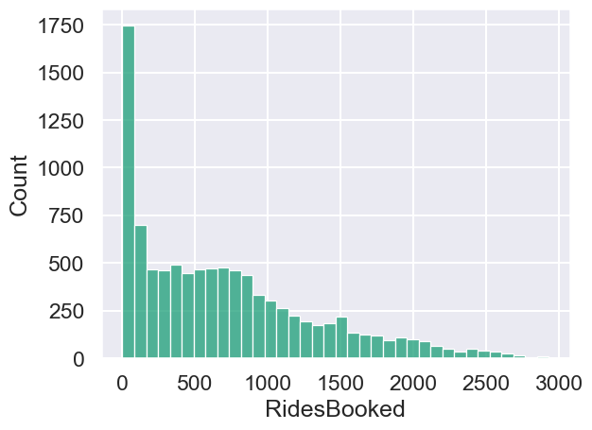
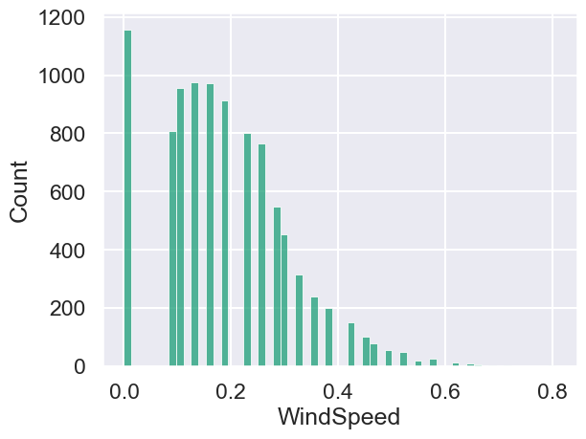
Data Exploration and Understanding
Important aspects that we found:
skewness in RidesBooked variable
‘blank spaces’ in histograms of Windspeed and Humidity
Notes:
Worth mentioning – registeredusers + nonregistered users are not ridesbooked / probably they are the numer of customers and not ordered rides - graphs

Slide 3
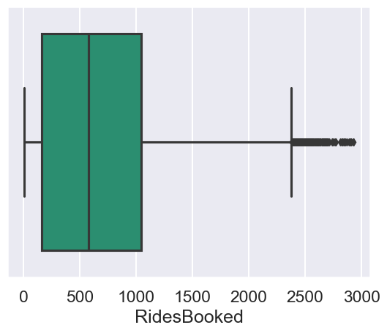
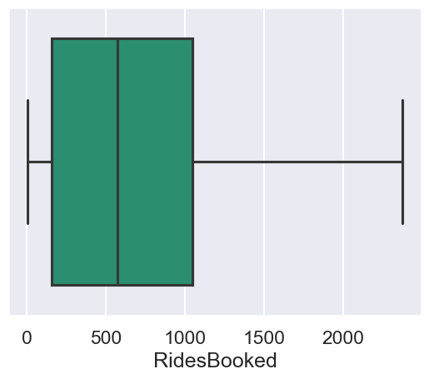
Data Preprocessing
The key processes that were done:
converting Month and DayofWeek variables into numeric
fixing outliers - replacing them at the whiskers of the boxplots
creating a new feature - Date
grouping the dataset by by Date, DayofWeek, HourofDay and Month
Notes:
removing the city_detroit

Slide 4
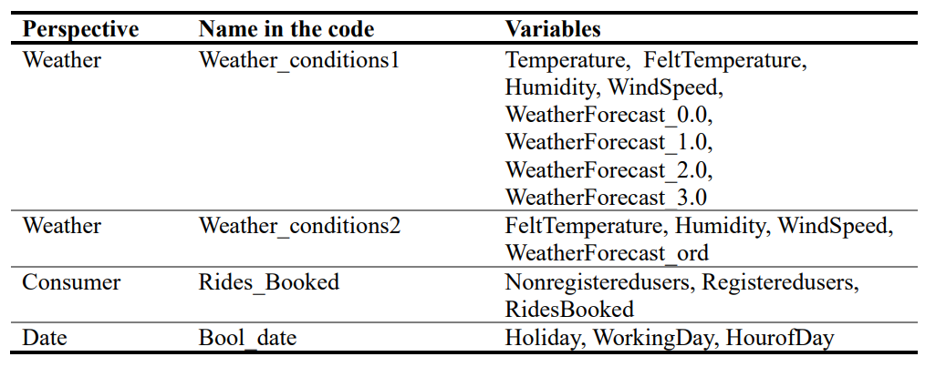
Scaling and feature selection
For scaling and feature selection we performed:
MinMax Scaling
Spearman correlation combined with the pairplots
created 3 different perspectives

Slide 5
Models
For modelling we utilized:
K-means
K-modes
Additionally, we used three different approaches to define number of clusters “k”:
„elbow” method
dendograms
silhouette score
At the end we visualized the results using the pararel plots and histograms.

Slide 6
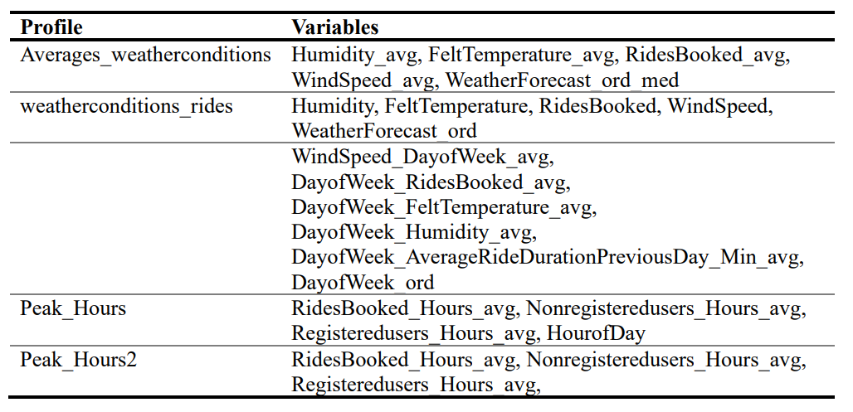
Model assessment
To improve our models, we:
explored the possibilities to clustering with both the categorical and numerical features
changed the number of clusters “k”
created 4 profiles for better understanding of the data
deleted the Temperature variable
merged the perspectives

Slide 7
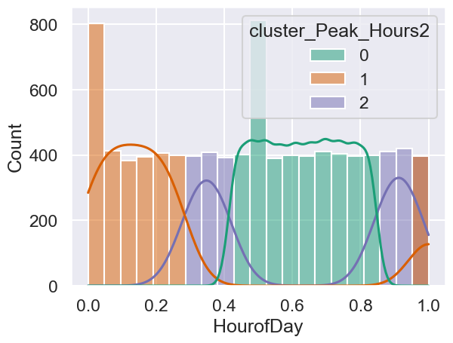
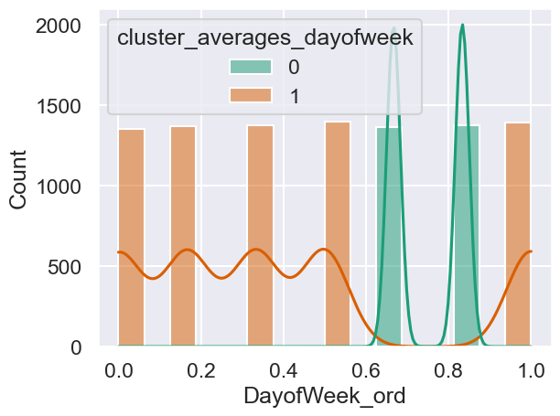
Profiles
HourofDay histogram for profile " Peak_hours2"
DayofWeek histogram for profile "averages_dayofweek”

Slide 8
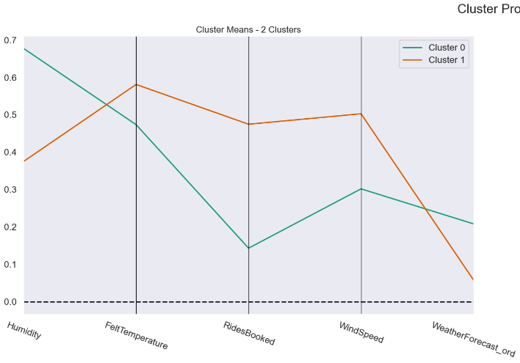
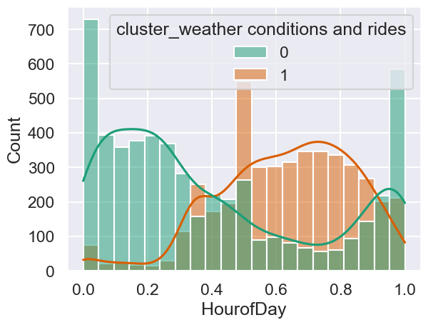
Profiles (2)
Plot for profile "weatherconditions_rides"
“HourofDay” histogram for profile "weatherconditions_rides"

Slide 9
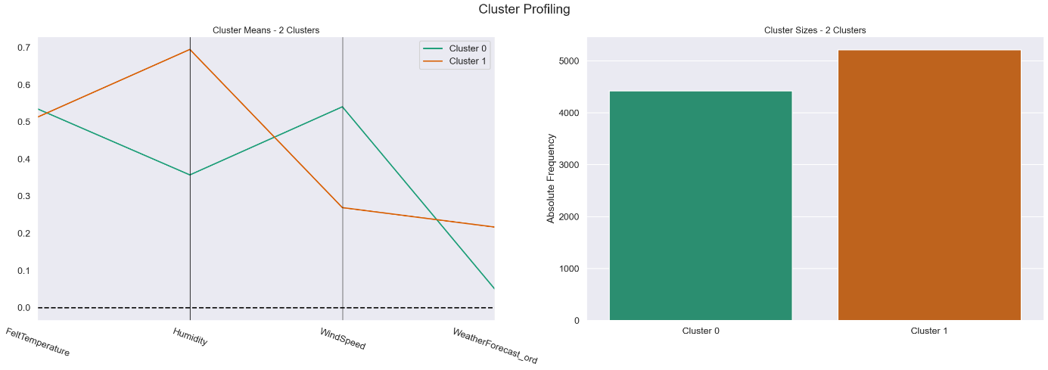
Perspective Weather_condition

Slide 10
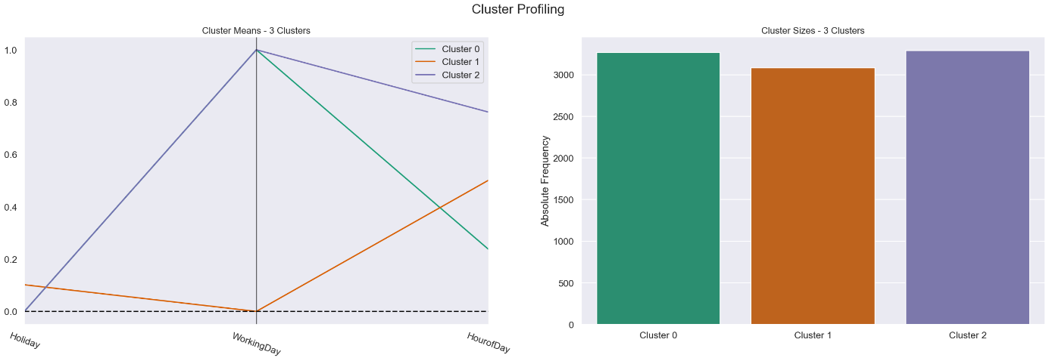
Perspective Bool_date

Slide 11
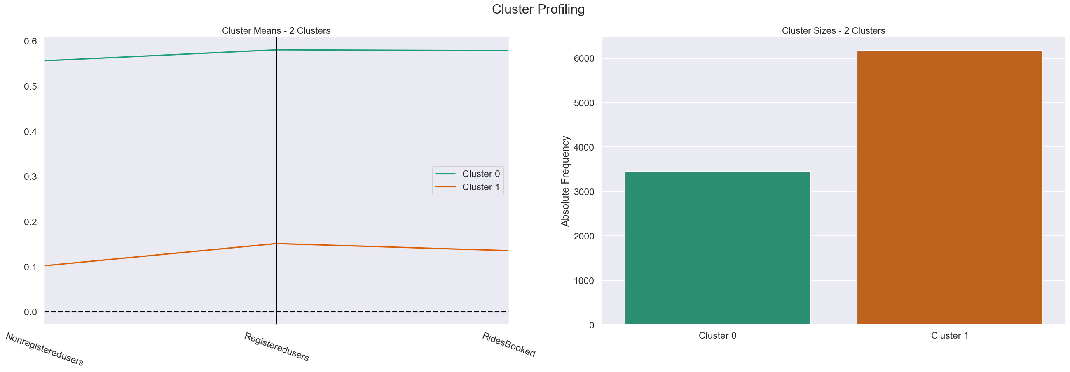
Perspective Rides_booked

Slide 12
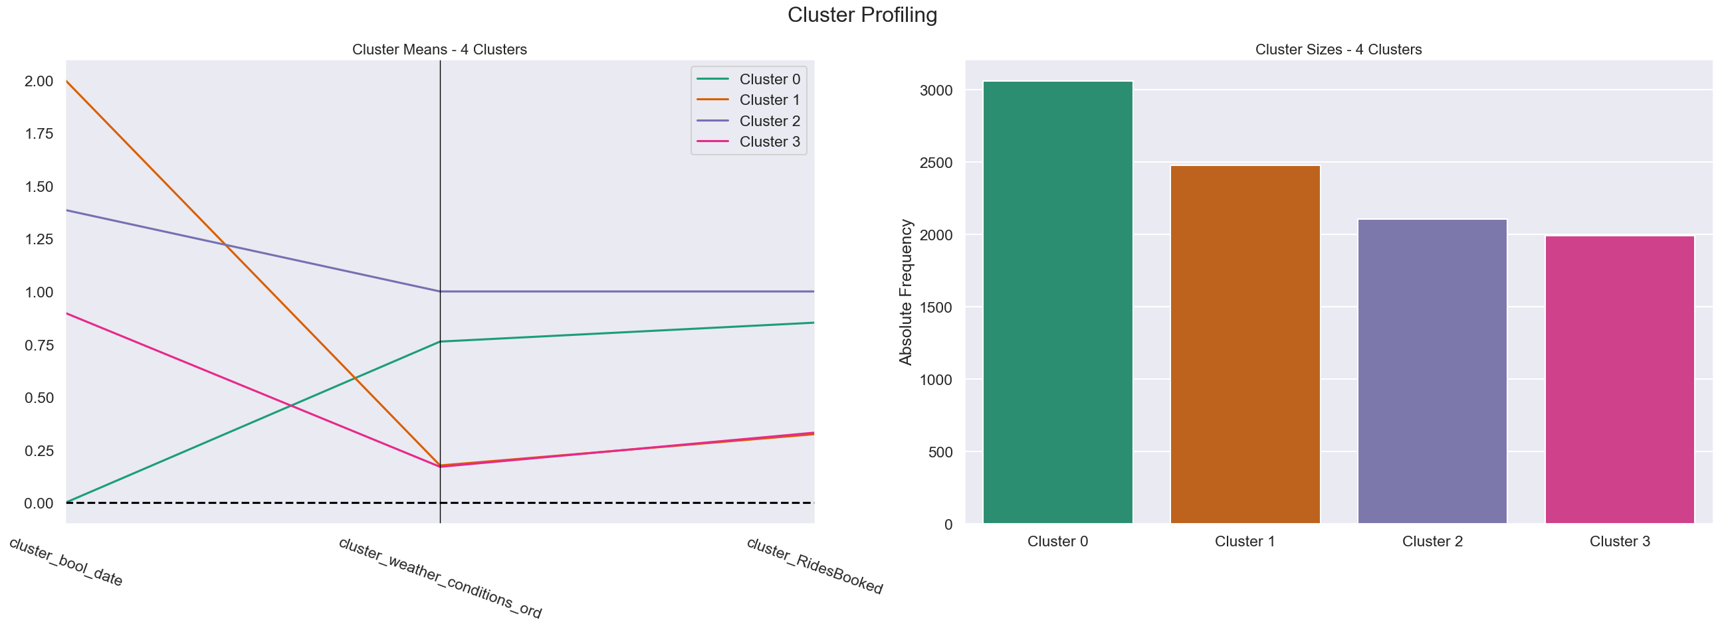
Clusters
From 3 perspectives we obtained 12 “semi” final clusters, that later were merged.
The final number of clusters is 4.

Slide 13
Results
The main results from our work are:
4 different associacion rules, that could explain the customer behavior
3 variables, that influence the customer behavior the most
In the mornings of working days with poor weather, there is a low number of rides ordered.
Regardless of the time of day, when the weather conditions are unfavorable, there is a minimal number of booked rides.
During favorable weather, particularly in the afternoons of working days, there is a high volume of rides booked.
On holidays (non-working days) with favorable weather, there is a significant increase in the number of rides booked.

Slide 14

Results
HourofDay
Weather
Conditions
WorkingDay

Slide 15

Thank you!
Morada: Campus de Campolide, 1070-312 Lisboa, Portugal
Tel: +351 213 828 610 | Fax: +351 213 828 611

